Slide 1

Designing for Trust in AI: A Multi-Wave Study of Copilot
Jeremy Heyer, MsHCI, MPH, MHI

Slide 2

Framing the Work – Context & Objectives
Copilot was in early stages of deployment to internal support roles using Dynamics for Microsoft (DfM) a CRM tool
Stakeholders needed to know:
Does it help reduce workload?
Do users trust it?
Is it accurate?
What features are sticking?
There was no baseline for user trust, value perception, or productivity impact
My role: Design and lead foundational research to define these baselines and guide product direction

Slide 3
Overview of Case Study & Impact
Initiated foundational research to define what success and trust look like to users
Launched 3 waves of mixed-method research as Copilot was integrated and expanded (n=21, 686, 598)
Created the AI UX Composite Score framework to track satisfaction, lack of trust, usefulness, and value over time
Enabled data-informed product strategy across PM, Eng, and SLT/LT

Slide 4
Case Study

Slide 5

Tracking the Cracks - Measuring and Rebuilding Trust in Copilot
Problem Statement: Copilot launched without a clear understanding (or measurement) of how it would be trusted by support engineers or evaluated by the business. We needed to define what trust meant, measure it, and track how it changed over time.
User satisfaction declined: 120 (good) → 111 → 88 (poor)
Only 40% of engineers said Copilot made their tasks easier
Engineers appreciated ease-of-use but didn’t trust outputs due to hallucinations, broken links, and inconsistency in output

Slide 6
Research Approach: Survey + Qual
Longitudinal survey (Waves 2–4)
Developed a custom AI Composite Score to measure trust signals
Statistical Tests:
Wilcoxon Signed Rank (wave 2) – to test whether observed satisfaction scores differed significantly from a hypothetical baseline
Mann-Whitney U – to compare scores across survey waves (non-parametric, as data wasn’t normally distributed)
Key Driver Analysis (Adj. R² = 0.87) (wave 2 and 3)– to identify key predictors of trust and satisfaction (e.g., poor accuracy, poor productivity)
Thematic analysis of open-ended responses to surface top pain points and confidence gaps

Slide 7
What the Data Told Us: Trust, Accuracy, and Impact

Slide 8
AI Composite Score
The AI Composite Score blends elements from the AI Trust Score, AI productivity measures, and perceived work usefulness to capture a holistic view of user confidence and impact regarding AI.
USEFUL
USABLE
VALID
I would be disappointed if I could not use Copilot
Perceived usefulness AIX
VALUE
Efficiently and effectively
AIX productivity
AIX productivity
Accurate and relevant
Perceived usefulness AIX
Copilot is easy to use
Notes:
Justin

Slide 9
AI Composite Score: Across Waves
Participants consistently indicate that Copilot is easy to use, but there is a continuing downward trend across the target metrics showing that DfM Copilot is not yet supporting intended efficiency gains.
58/100 COMPOSITE SCORE
USEFUL
USABLE
VALID
I would be disappointed if I could not use Copilot
VALUE
Efficiently and effectively
Accurate and relevant
Copilot is easy to use
Error bars represent 90% Confidence Intervals
Wave 4, n = 598;
Wave 3, n = 686;
Wave 2, n = 21
All data shown has been de-identified, and sensitive details--including metrics, user quotes and internal processes--have ben modified or generalized to protect confidentiality.
Notes:
Justin

Slide 10

DfM Copilot Survey Metrics
Comparative Metrics Wave 2 - 4
Wave 2
Wave 3
Wave 4
Copilot has a ton of potential, but the inconsistency in its output means I have to double-check everything it suggests. Often, key steps are missing or flat-out wrong, which ends up costing me time instead of saving it. Once it becomes more accurate and reliable, it’ll be a real asset — but right now, it feels more like extra weight I have to carry."
Satisfaction |  | NSAT
Overall, how satisfied are you | 120 | 111 | 88
AI Trust- Productivity | % Top 2 | % Top 2 | % Top 2
Efficiently and effectively | 70% | 60% | 40%
Accurate and relevant | 60% | 40% | 30%
Copilot is an improvement to how things are done today | 80% | 60% | 50%
Copilot functionality should be expanded | 80% | 70% | 40%
AI Trust- Usefulness
Work tasks easier | 70% | 50% | 40%
Reduces the amount of work I have to do | 40% | 40% | 40%
I would be disappointed if I could not use Copilot | 50% | 40% | 50%
Copilot is easy to use | 90% | 70% | 70%
Rating Scale:
>= 80% rating
70% - 79% rating
<70 % rating
N=21
N=686
N=598
All data shown has been de-identified, and sensitive details--including metrics, user quotes and internal processes--have ben modified or generalized to protect confidentiality.

Slide 11
Satisfaction for Copilot was Poor, which was significantly lower than the previous wave, due to a decrease in the percentage of “Very Satisfied” responses (- 20%)
A Mann-Whitney U test was performed to evaluate whether there was a difference in Satisfaction for Copilot between survey waves. Results revealed significantly lower satisfaction between waves 3 and 4. U = 190941, p < .001
Overall, how satisfied are you with Copilot?
SAT = 88 (+/- 4)
Target = 120
Interpreting NSAT Scores
Very Good
Good
Neutral
Poor
Very Poor
>= 130
= 110 - 129
= 90 - 109
= 70 - 89
<= 69
Very
dissatisfied
Somewhat
dissatisfied
Neither satisfied nor dissatisfied
Somewhat
satisfied
Very
satisfied
MoE (+/-) represents 90% Confidence Intervals
Wave 2, n = 21
Wave 3, n = 686;
Wave 4, n = 598;
All data shown has been de-identified, and sensitive details--including metrics, user quotes and internal processes--have ben modified or generalized to protect confidentiality.

Slide 12
Key driver analysis (Adj. R^2 = .734) showed those who felt Copilot took away from productivity or had poor accuracy tended to have lower overall satisfaction with the experience
Trust in AI variables that significantly contribute to Overall satisfaction with Copilot in DfM
“There’s clear potential in Copilot, but the reliability of its sources continues to be an issue. Many responses aren’t accurate.”
“I’ve seen Copilot suggest commands that don’t exist, link to documentation that isn’t real, and describe bugs that aren’t actually present. It often generates content that sounds confident but is factually off.”
“The most consistent issue I’ve encountered is how often Copilot delivers inaccurate responses.”
n=686
Adj. R^2 = .734
%’s represent the Variable Importance. Variable Importance indicates how much of the variance (.734) is accounted for by a variable in the model.
All data shown has been de-identified, and sensitive details--including metrics, user quotes and internal processes--have ben modified or generalized to protect confidentiality.

Slide 13

Copilot was not perceived to improve productivity with inaccurate data requiring users to double-check information, thus the idea of expanding further was no longer ideal.
“Copilot’s information isn’t reliable enough yet to be fully trusted, which means users often have to verify the outputs manually — adding friction and costing time.”
Trust in AI – Productivity
Average = 50 (+/- 2)
Target = 75
Agreement scales scores converted to 0–100-point scale
Strongly agree = 100
Somewhat agree = 75
Neither agree nor disagree = 50
Somewhat disagree = 25
Strongly disagree = 0
Error bars represent 90% Confidence Intervals
Wave 4, n = 598;
Wave 3, n = 686;
Wave 2, n = 21
All data shown has been de-identified, and sensitive details--including metrics, user quotes and internal processes--have ben modified or generalized to protect confidentiality.

Slide 14
What Users Told Us: The Story Behind the Scores

Slide 15
Research Approach: Deep Dive Discovery
Qualitative Interviews / Hybrid method
12 Support Engineers
> 1 year of technical experience with DfM
All currently part of Copilot integrations (expansion)
60-minute interview
Experience/ concept walkthrough
Deductive thematic analysis of user sentiment and engagement feedback with live environment, using predefined categories like trust, usefulness, and accuracy

Slide 16

Copilot: The Bright Spots
Case Summary
Case Summary was considered valuable and the best Copilot feature
“Case Summary is the only Copilot feature I use.”
“I love how it drafts the summary and saves me time.”
“Copilot makes writing emails faster and easier.”
“The case summary functionality is awesome; it gets it right 95% of the time.”
“It creates a summary of the case that is one of its best features.”
“Super duper clear and concise [case] summary!”
This feature was seen as reliable, time-saving, and low-effort to use

Slide 17

Copilot: The Low Lights
Accuracy, Trust & Adoption Barriers
“Copilot frequently gives wrong or even made-up info.”
“It recommends commands and bugs that don’t exist.”
“I have to double-check everything — it’s not efficient.”
Broken Sources & Dead Links
“Often Copilot will show links that just don’t work.”
“I can’t verify anything because the source is missing or incorrect.”
“No link means I don’t trust the answer.”
Usage Is Limited by Trust
Users rely on Copilot for simple tasks only.
Mistrust and broken references limit deeper adoption.
Onboarding support exists but doesn't fully prepare users for effective use.

Slide 18
What We Learned
Users view Copilot as a promising tool with room to grow, particularly as its training data and case coverage improve.
Across the workflow, Copilot is commonly used for task initiation, case summarization, emails, and handling simple queries.
For complex or technical scenarios, Copilot’s accuracy remains a concern. Inconsistent responses have impacted user trust and could hinder long-term adoption.
Trust is most affected by inconsistent outputs, questionable sources, and confidently incorrect responses.
Current usage is largely focused on low-complexity tasks, which restricts the perceived value of Copilot’s broader capabilities.
While onboarding resources exist, they often fall short in preparing users to leverage Copilot efficiently and effectively.

Slide 19
Driving Change Through Influence
Who I Influenced:
Product Managers, Engineering leadership, Content Design, and the VP of Copilot Experiences
How I Influenced:
Conducted a roadshow of presentations tailored to different audiences
Presented in 1:1s, org-wide meetings, team-specific reviews, and executive-level briefings
Used storytelling artifacts and research synthesis to evangelize findings and create alignment

Slide 20

Creating a Shared Understanding
Why Does Influence Matter?
Driving change in large organizations requires visibility and credibility
Teams were often committed to assumptions that didn’t reflect actual user needs
To affect the roadmap and product decisions, we had to earn trust and establish a shared understanding
This enabled cross-functional buy-in for meaningful design and strategy pivots

Slide 21
Design Directions, Tradeoffs, & Impact

Slide 22
Design Direction
Design Directions
Deprioritized Multi-turn UPDATES (low trust, 14k thumbs down)
Doubled down on Case Summary and Email Assist
Recommended redesign of micro feedback (thumbs up) to improve signal quality
Design direction focused on building trust before expanding capabilities

Slide 23
Key Tradeoffs
Key Tradeoffs
Did not pursue broad feature expansion in Copilot
Delayed efforts to retrain on new content or expand domain coverage
Prioritized building confidence and trust over new functionality
Tradeoffs were made intentionally to improve retention and user adoption

Slide 24

Measurable Impact & Outcomes
Case Summary received 90%+ thumbs up and saw a steady increase in weekly usage
Copilot retention stabilized around ~60% after 11 weeks
Our research directly shaped the Copilot roadmap prioritization
Sparked additional work:
Micro feedback discovery project (led by me)
Prompt Engineering training and discovery (led by me)

Slide 25
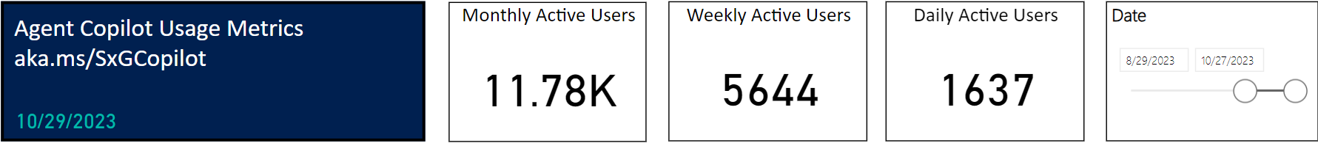
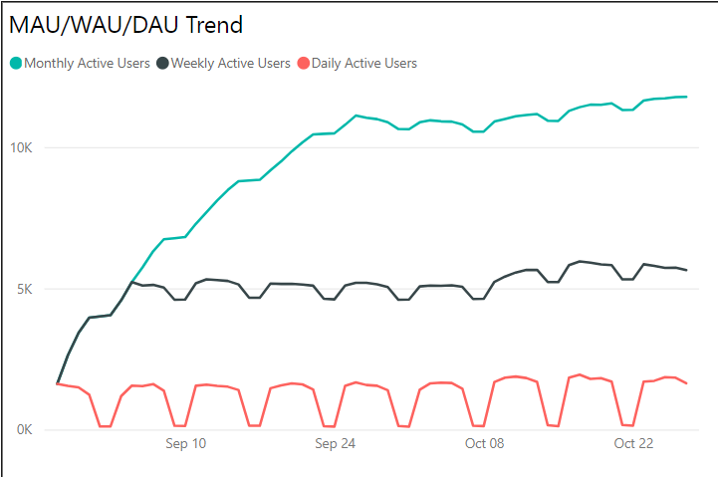
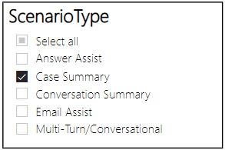



Case Summary shows increased engagement and positive feedback due to output accuracy and time saved on case
Case Summary was considered valuable and the best Copilot feature
“The case summary functionality is awesome; it gets it right 95% of the time.”
“I love how it drafts the case summary and saves me time to read through all the notes.”
Monthly shows a steady increase along with Weekly despite an end of Oct dip
“Case Summary is the only Copilot feature I use.”
Agents returning to explore potential accuracy improvements likely contribute to stable but not increased DAU.
All data shown has been de-identified, and sensitive details--including metrics, user quotes and internal processes--have ben modified or generalized to protect confidentiality.

Slide 26
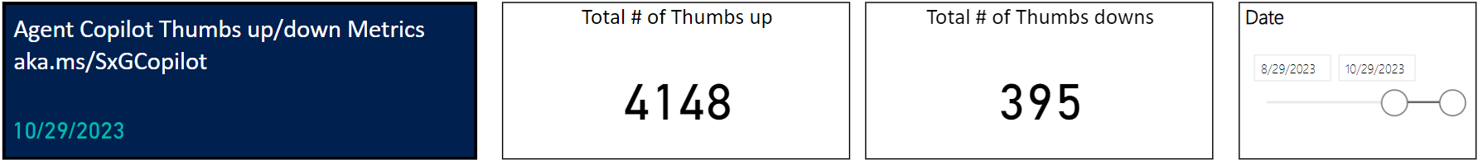
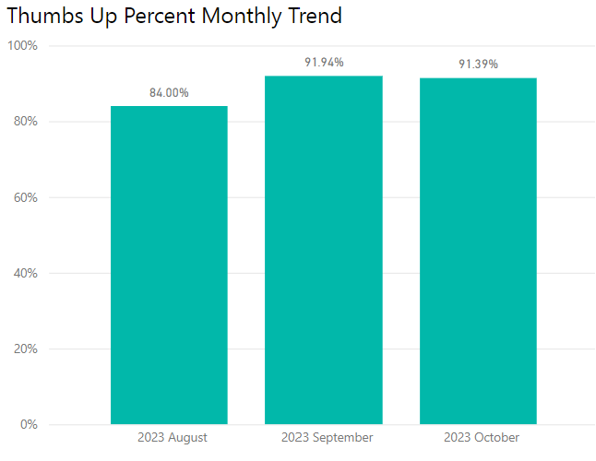
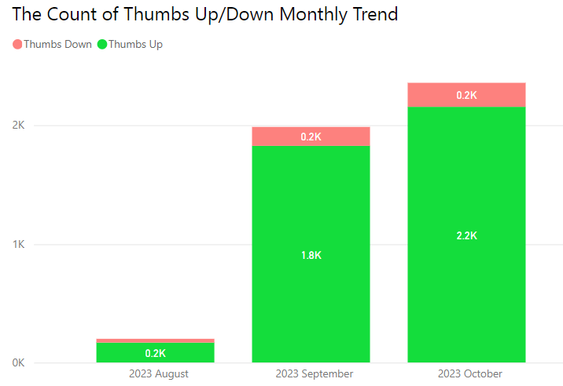
A positive thumbs up trend with Case Summary is likely attributed to output validity and reliability
Case Summary was considered valuable and the best Copilot feature
Percent of thumbs up has trended to 90%+ over two months with the overall count increasing from 1.8k to 2.2k.
This increase in user-initiated thumbs up likely attributes to output validity, suggesting that as Case summary produces more reliably accurate output, user sentiment and usage should increase.
All data shown has been de-identified, and sensitive details--including metrics, user quotes and internal processes--have ben modified or generalized to protect confidentiality.

Slide 27
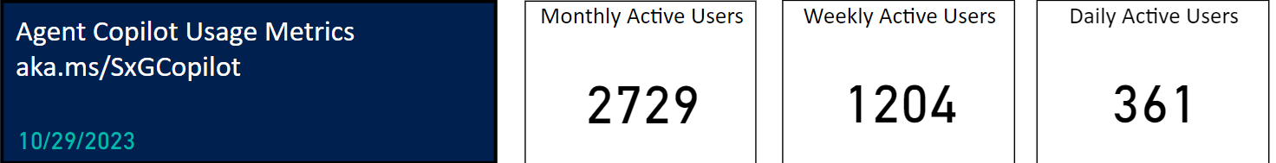
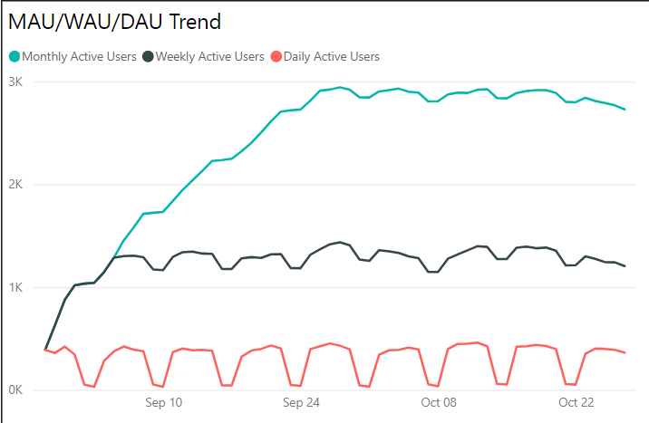
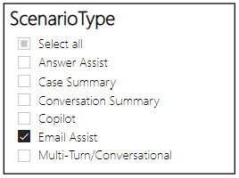
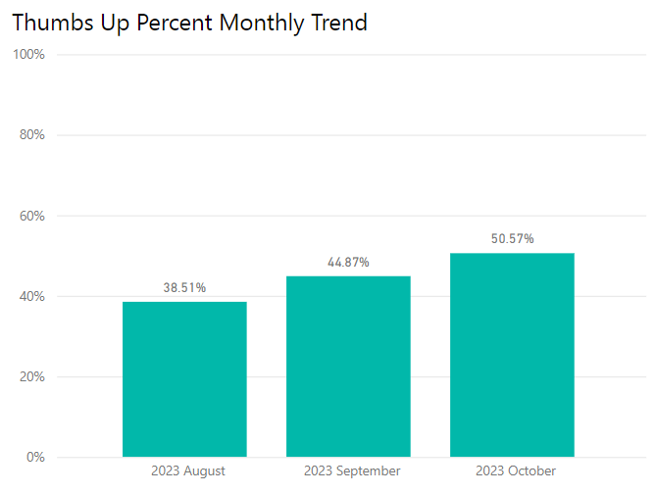
Despite low usage, users find Email Assist useful and provided positive feedback as co-authoring emails saves time and minimizes user input
Leveraging Copilot to co-author emails saves time and minimizes user input
“All in all, Copilot makes writing emails faster.”
“Email creation is time-saving when working cases.”
The lack of human touch/ personalization to Email Assist output contributes to stable usage (with mild decreases).
Despite not being immense growth, user sentiment around Email Assist output validity has continued to rise.
All data shown has been de-identified, and sensitive details--including metrics, user quotes and internal processes--have ben modified or generalized to protect confidentiality.

Slide 28

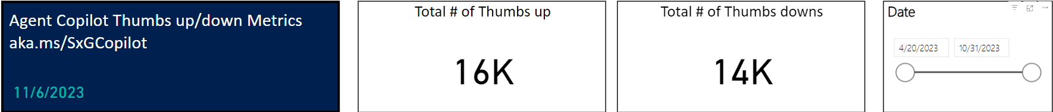
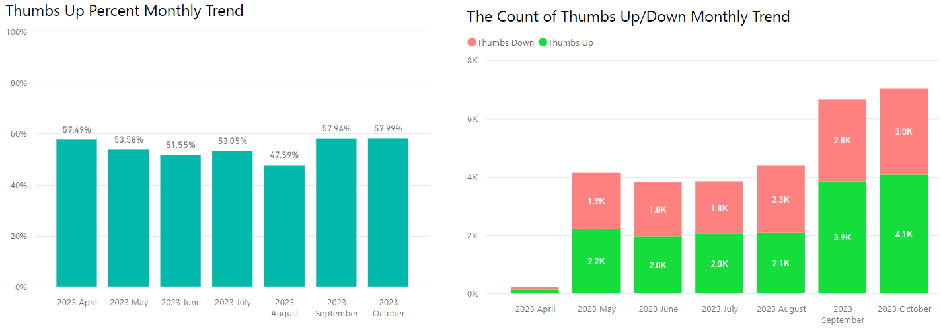
~46% of thumbs down represents user concerns over Copilot accuracy and reliability when using Multi-turn
Telemetry shows there are 14k thumbs down (30k total reported micro feedback) regarding Copilot Multi-turn output. This indicates that users find ~46% of the returned content after prompting to not be satisifactory for various reasons.
User verbatims from previous research studies show user concerns over accuracy and relaibility of output (especially regarding complex tasks, and inconsistent/absent/broken source content). This is futher supported by survey results from wave inititaves.
It should be noted that thumbs up/ down micro feedback could potentially be misinterrepted by the user and associated with providing feedback to the overall Copilot experience and not just Multi-turn output.
“I rarely see sources for the information being provided which makes it even more difficult to validate information.”
“ALL answers need to be double-checked and verified, I currently see no real benefit and it does not seem to increase efficiency.”
“Hallucinations are grammatically correct and contextual making it difficult to determine what is factually accurate.”
“Some answers state to check the reference article, but sometimes one never populates. After I ask where's the document, I get a reply stating there are no reference articles.”
All data shown has been de-identified, and sensitive details--including metrics, user quotes and internal processes--have ben modified or generalized to protect confidentiality.

Slide 29
Thank You!
Jeremy Heyer
Jeremy.Heyer01@gmail.com

Slide 30
Q&A

